Slide 1

Code style:
Why is it important?

Slide 2
Context is important
Coding style is a way to make code looking simple, structured and unified for you. It helps you read and understand source code easily.
The context of “you” here is really important.
“You” is not the one who wrote the code.
“You” is the one who reads it and supports it in future.

Slide 3
Why do we need code style?
The main problem is that we all are unique. Everything we do unintentionally expresses ourselves. So does our code.
It is personal.
The personalized nature of coding style is a challenge in a team atmosphere.

Slide 4
Why do we have to follow a specific code style?
A great example is people forming a musical band.
You can’t create a good song playing different melodies. They can be good separate, but working together needs not only a talent or great musical instruments.
A key to create a good song is the harmonization. When one complement another.
The larger band is, the harder it is to maintain harmony. This is where band-master appears. In our case this is a code style.

Slide 5
What is all that “code style” about?
Code style is not only about braces and idents.
This is also about patterns and how our brain gets the information.
Having a variety of patterns helps our brain to spend our energy and time efficiently. Our brain is very lazy and very gluttonous, so it does it’s best to spend our resources as few as possible.
When we write code it is very important to keep it consistent and clean. Good code should be as simple to understand as reading a book.

Slide 6

Here is an example of our brain reacting to code

Slide 7
“Fastest eye in the west”
If you noticed, lower example was much more efficient in his eye movements, so was his answer.
The lower one frame with eye capture device represents experienced developer. The upper frame represents junior developer.

Slide 8
Laziness is the benefit
Junior developer spends a lot of time just to understand the concept of the code, while experienced developer just quickly checks block patterns to get the quick understanding of code.
Let’s look on code examples from the next two slides.

Slide 9
Example 1
class TestClass{ String var1 = '!', var, mv = 'Hello, {0}{1}', sf; TestClass() { if(var == null) var = 'Init stage'; else var = ''; System.debug('-----\/\/\/-----'); sfget(); } print() { var = 'Printing hello World template to console using extra long and unnecessery detailed string that is longer than 150 symbols and I don't even have an intent to wrap it to fot the monitor and make someone's life easier while reading it'; SYstem.debug(gethello()); } public void sfget() { sf = UserInfo.getFirstName(); } gethello() { String.format(mv, new List<String>{sf, var1}); }}

Slide 10
Example 2
/* * Test class proving a concept of good styling and readability of code */ class HelloWorldHelper{ public static final String helloWorldTemplatePhrase = 'Hello, {0}{1}'; public static final String exclamationMarkSymbol = '!'; private String currentExecuteStage; private String currentUserName; public HelloWorldHelper(){ if(this.currentExecuteStage == null) { this.currentExecuteStage = 'Init stage'; } else{ this.currentExecuteStage = 'Re-initialized'; } System.debug('HelloWorldHelper constructor initialized'); fetchSalesforceUserName(); } private String getHelloPhrase(){ String helloPhrase = String.format(helloWorldTemplatePhrase, new List<String>{currentUserName, exclamationMarkSymbol}); return helloPhrase; } public printHelloWorldTemplateToConsole(){ this.currentExecuteStage = 'Printing hello World template to console using extra long and unnecessary detailed string ' + 'that is longer than 150 symbols and I don't even have an intent to wrap it to for the monitor and make someone's ' + 'life easier while reading it'; System.debug(getHelloPhrase()); } public void fetchSalesforceUserName(){ currentUserName = UserInfo.getFirstName(); } }

Slide 11
The benefits of code style:
1. Provides linear development of the project and does not affect the size of the code base
2. Significantly speeds up the adaptation process for new programmers
3. Removes dependencies on individualities

Slide 12
The benefits of code style:
4. Minimizes the mental blocking effect when learning a new code
5. Minimizes reputation losses
6. Forms and fosters a development culture

Slide 13
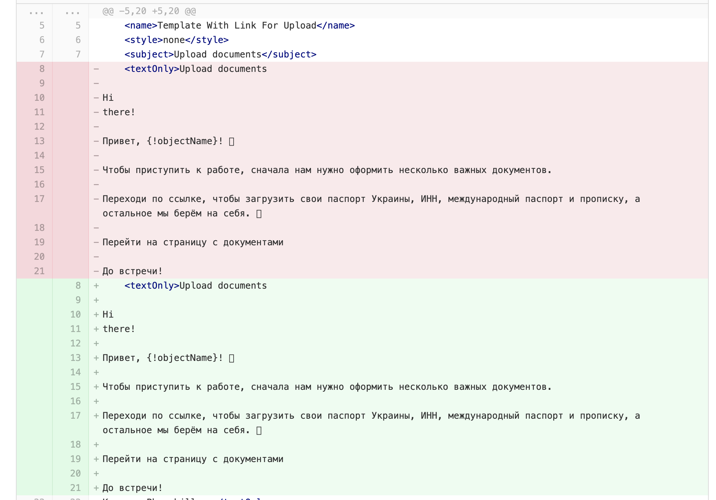
“What could go wrong?”

Slide 14
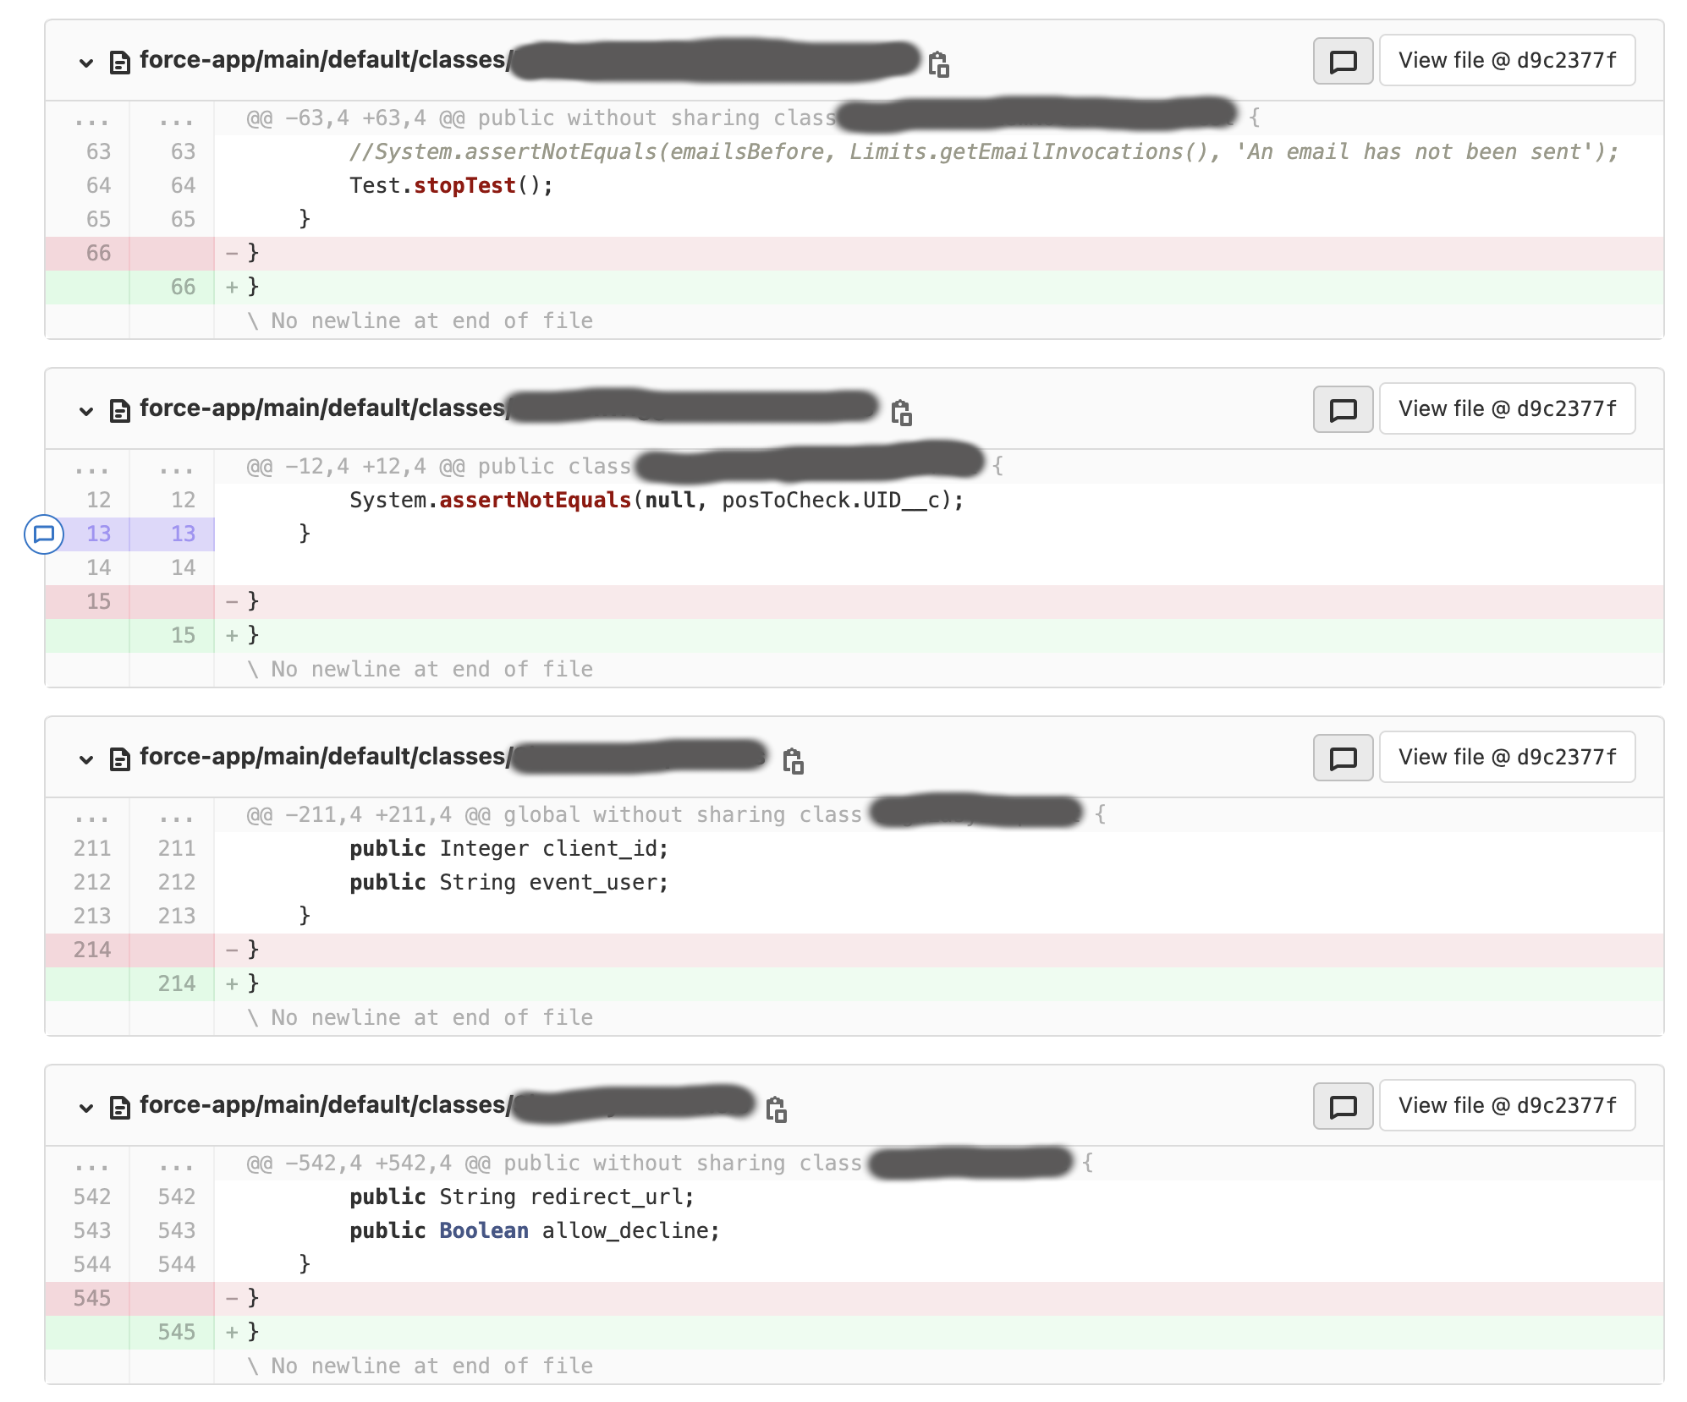
“What could go wrong?”

Slide 15
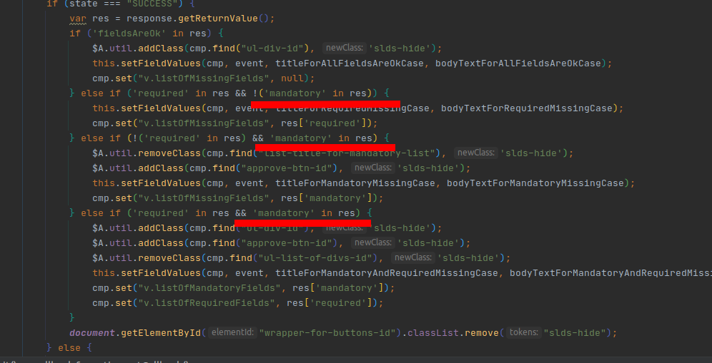
“What could go wrong?”

Slide 16
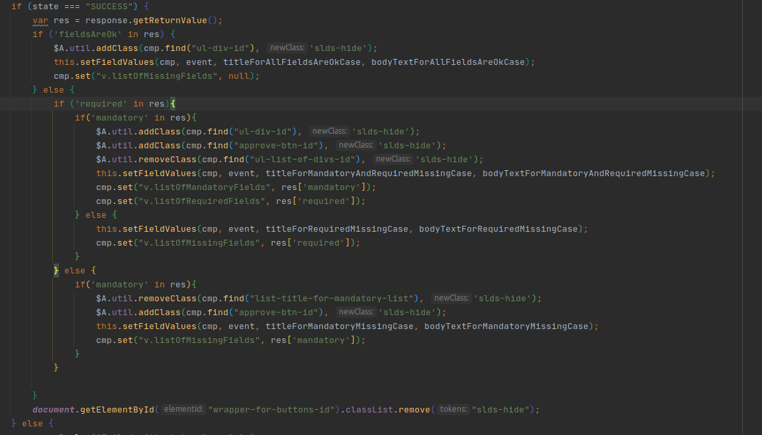
“What could go wrong?”

Slide 17
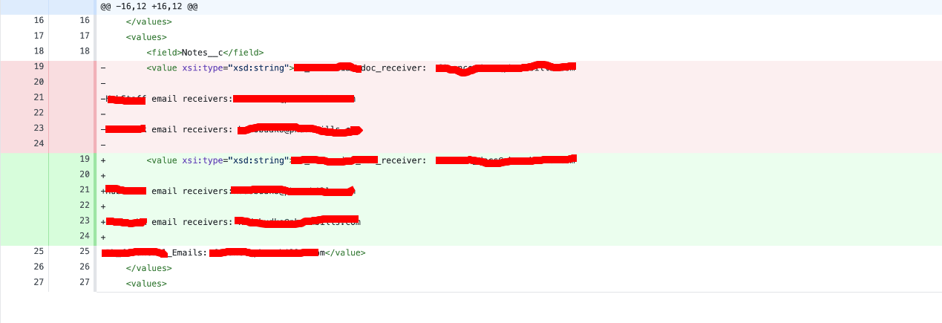
“What could go wrong?”

Slide 18
Inspired by:
“How Do You Define “Good Code”?” by Eran Kampf, Jun 26, 2008
“Why Coding Style Matters” by Nicholas C. Zakas, Oct 25, 2012
“Code style как стандарт разработки” by ManyChat, Sept 26, 2019

Slide 19
Koroka Code Style:
Code style can be found here: link
P.S. If you have any difficulties with implementing code style manually, you can try IDE (VS Code, Intellij Idea) code formatting.
P.S.2.0 VS Code doesn’t provide out of the box support of Apex, so you need to install following plugin. Configuration file for it can be found in the description or in the same repository.

